Slide 1
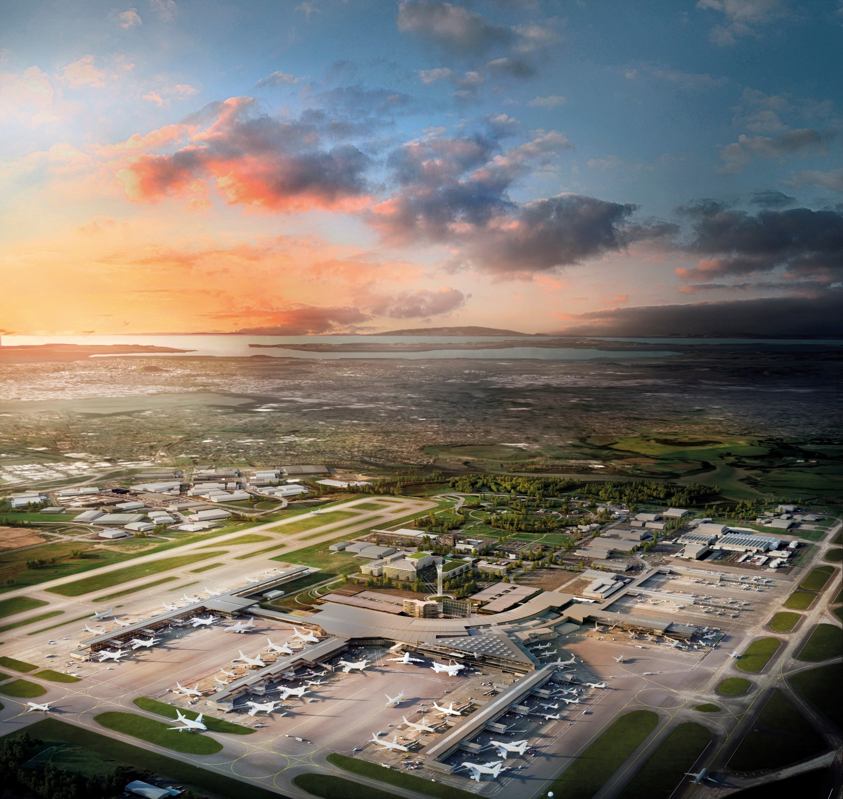
Southern Link Conference
June 2019

Slide 2
Movement of Goods
Setting the scene: Goods flows today
Objectives for today
Questions to get us started

Slide 3
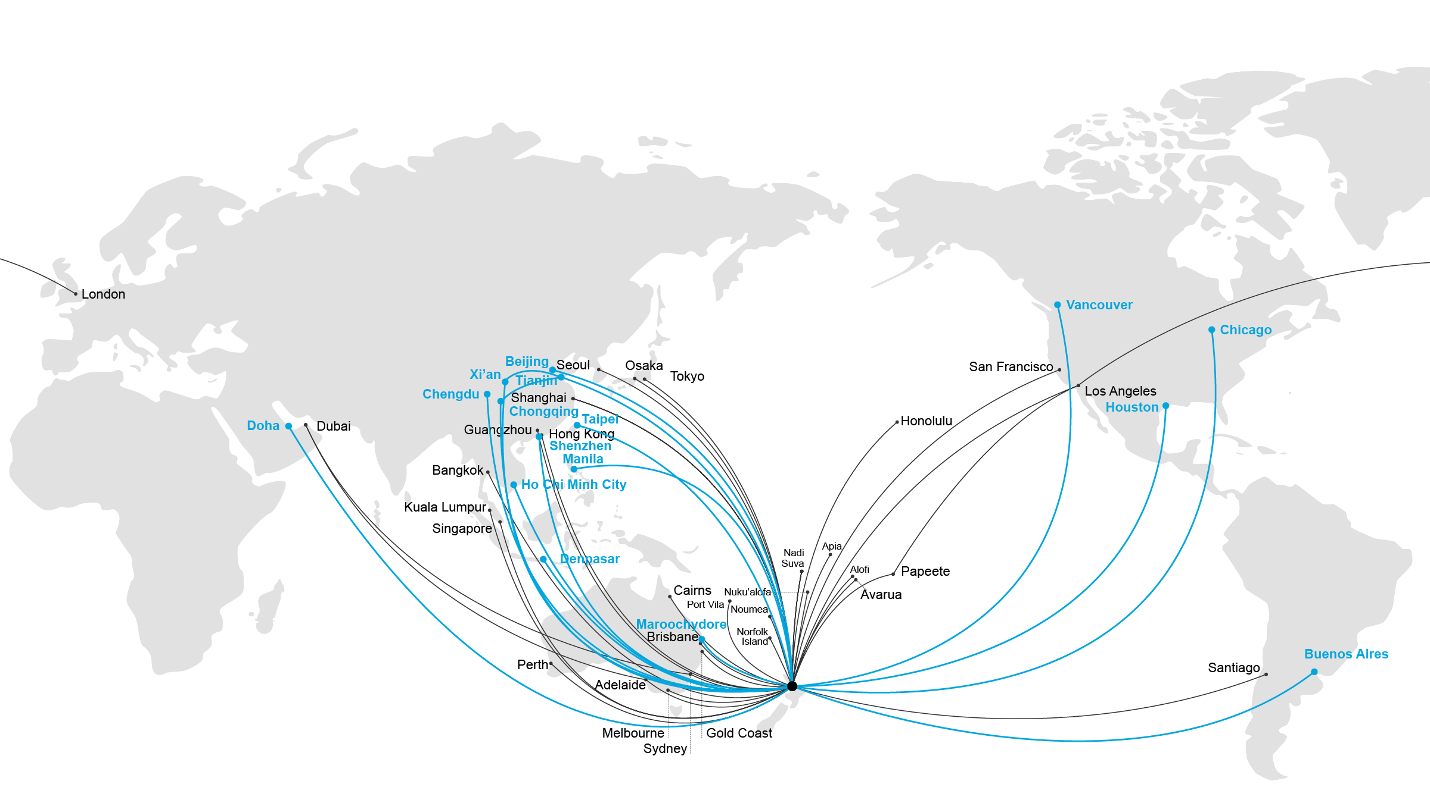
Goods trade today is already significant
>$75b
USD
Value of trade between Southern Link countrie
China
16b
43b
17b
170m
Level of trade that NZ could get involved in
Argentina
NZ
200m
Chile
+$50b
USD

Slide 4
Objectives from this session
Establish a working group
Who here wants to be involved on taking this forward after today?
Confirm our hypothesis
Is there a significant opportunity here worth pursuing for NZ?
List out the opportunities
What are the opportunities, for whom, and what do they require?
Set actions and owners
What do we need to do after today and who will do it?

Slide 5
Questions to think about
1
What is the opportunity to grow trade flows between China and South America via NZ?
Once established, how could NZ exporters leverage these routes to grow?
Is there a supply chain benefit for NZ businesses from being a hub for this trade?
2
3

